Slide 1

“E-COMMERCE WEBSITE”
Task - 1

Slide 2

Money Transfer Application
▪
A Money Transfer Application offers a secure and user-friendly solution for seamless fund transfers and financial management, empowering developers to create a cutting-edge financial tool.
LMS Username
Name
Batch
AU420420205019
NILAMAGAN J
CA02
AU420420205304
MOHAN RAJ J
CA02
AU420420205305
GOPI M
CA02
AU420420205007
GANESAN k
CA02

Slide 3

Task-1
Creation of SRS &Github
▪
▪
▪
Create SRS:“E-COMMERCE WEBSITE”
Creation &Set-up of Github account
Creation &Hands-on to various commands of Git Bash
Evaluation Metric:
● 100% Completion of the above tasks
Learning Outcome
▪
▪
▪
▪
Get to know about different lifecycle models.
Understanding importance and how to create an SRS
Knowing various commands of Github
Understanding agile and scrum management techniques for efficient product development

Slide 4



Introduction:
Introducing a secure and user-friendly Ecommerce platform, redefining online shopping. With features like seamless browsing, enhanced security, and 24/7 support, we empower users to shop conveniently and confidently. Join us in shaping the future of online retail.
Examples:
Amazon is a renowned e-commerce and technology giant, offering a vast online marketplace where users can shop for a wide range of products, from electronics to books. With a user-friendly interface, secure payment options, and quick delivery services, Amazon provides a seamless online shopping experience
Flipkart is a popular Indian e-commerce platform that offers a diverse range of products, from electronics to fashion items. With its user-friendly interface and reliable delivery services, Flipkart has become a go-to destination for online shopping in India.

Slide 5
Steps Involved in Development
Step-Wise Description
1. Project Planning and Design:
Define the application's scope, features, and target audience.
Create a detailed system design, including data models, user interfaces, and architecture.
2. Front-End Development:
Develop the user interface using HTML, CSS, and JavaScript.
Implement user registration, login, and account management screens.
Integrate with APIs or libraries for user interactions.

Slide 6
3. Back-End Development:
Step-Wise Description
Server Setup: Set up a backend server environment using Java, ensuring robust and reliable server capabilities.
Framework Utilization: Leverage a versatile framework like Spring Boot to expedite development, enhancing efficiency and scalability.
User Security: Implement stringent user authentication and authorization protocols, along with effective session management, to fortify user data and interactions.
API Development: Craft RESTful APIs to facilitate secure and seamless financial operations, including money transfers, balance inquiries, and transaction history retrieval

Slide 7
4. Database Setup:
Step-Wise Description
Select a Database System: Choose a suitable database system such as MySQL or PostgreSQL and set it up to provide a reliable data storage solution.
Schema and Table Design: Design and create the necessary database schemas and tables to efficiently store user data, account balances, and transaction records.
Database Integration: Implement seamless database connectivity in your Java application, either by utilizing JDBC (Java Database Connectivity) or an ORM (Object-Relational Mapping) framework. This ensures that your application interacts effectively with the chosen database system, facilitating data retrieval, storage, and management

Slide 8
Step-Wise Description
5. Security Implementation:
Data Encryption: Prioritize data security by implementing encryption mechanisms to safeguard sensitive information like passwords and transaction details.
Secure Communication: Employ secure communication protocols such as HTTPS to protect data during transmission, ensuring privacy and integrity.
Input Validation: Implement rigorous input validation to mitigate common security vulnerabilities, preventing malicious inputs and enhancing system resilience.

Slide 9
Step-Wise Description
6.TESTING :
Unit Testing: Validate individual components and functions through rigorous unit testing, addressing isolated issues effectively.
Integration Testing: Ensure seamless interactions between front-end and back-end systems with comprehensive integration testing, verifying the holistic system operation.
User Acceptance Testing: Assess application usability in user acceptance testing before deployment, aligning the system with user expectations and making refinements as required

Slide 10
Step-Wise Description
7. Deployment:
Deploy the application on a web server or cloud platform.
Configure domain settings and ensure scalability and availability.
Set up monitoring and error logging for maintenance.
8. User Documentation:
Create user guides or documentation to help users understand how to use the application effectively.

Slide 11
SUMMARY
SUMMARY
Step-Wise Description
A full-stack Java-based Ecommerce solution, combining front-end and back-end development, to deliver a comprehensive and secure financial management system. This platform includes features like user registration, authentication, fund transfers, balance inquiries, and transaction history. Built with Java, Spring Boot, HTML, CSS, and JavaScript, it ensures a seamless user experience with enhanced security measures. Successful implementation necessitates meticulous planning, integrated databases, rigorous testing, and ongoing maintenance to offer a reliable and user-friendly solution for efficient financial management

Slide 12
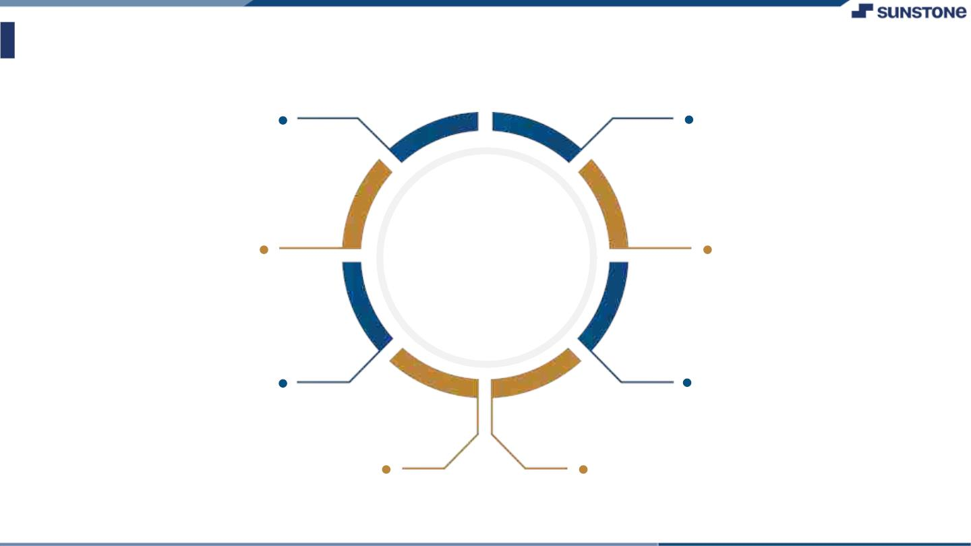
Assessment Parameter
Gather requirements for the
project
Add Readme.md file with
Description of the project
Prepare databasedesign
schemas
Check-List
Commit all changes with"first
commit"
Get your initial project
Structure ready
create arepository on github Realted to project
Initiate a git repository
Push your change to github

Slide 13
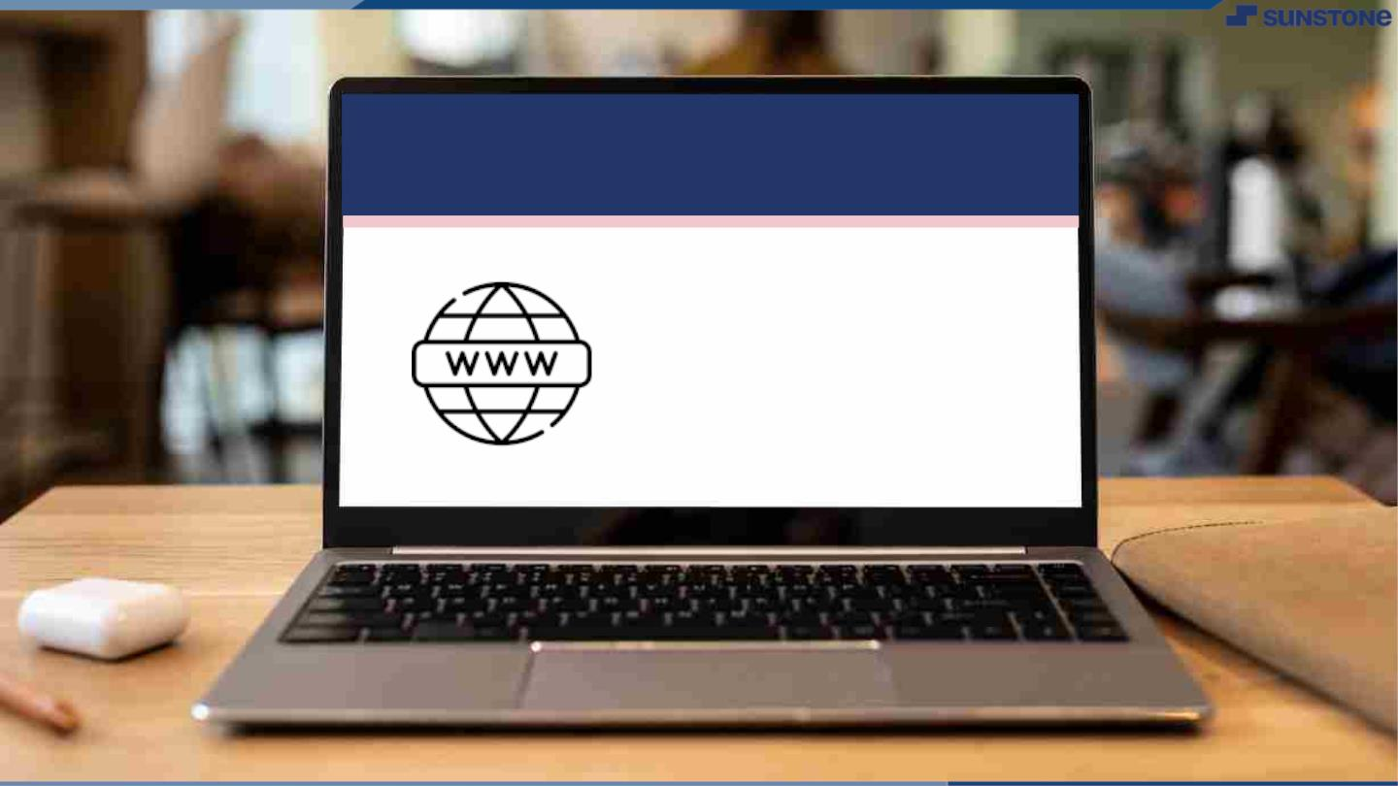
Submission Github
https://github.com/Sunderpechai/NM-APEC-IT-GROUP4

Slide 14


